Slide 1
COS 212 BST: Insertion & Deletion

Slide 2
Inserting a node into BST
So we know how to search & traverse the BST now
But how do we add nodes?
To maintain BST structure, apply the search algorithm to the BST, and insert the node where the algorithm takes you
Insert 4 into the following tree:
5
5
3
7
3
7
1
6
9
1
4
6
9

Slide 3
Inserting a node into BST
insert(el)
if root is null // tree is empty;
root becomes a new node with el;
return;
p = root;
while p is not null // find a place for inserting new node;
prev = p;
if el < element in node p
p = p.left;
else p = p.right;
if el < element in node prev
new node with el is attached to the left of prev;
else new node with el is attached to the right of prev;

Slide 4
Inserting a node into BST
20
30
null
20
25
10
15
20
20
20
30
30
10
30
25
25

Slide 5
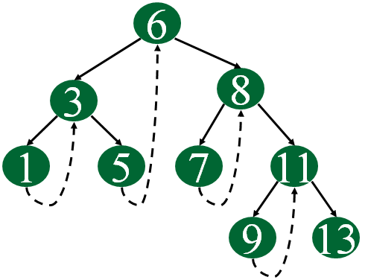
Inserting into a Threaded Binary Tree
Consider single-threaded binary trees:
If a node has a right child, then it does not have a thread
If a node does not have a right child, then it has a thread
Implications:
If the new node becomes a right child, it inherits the thread from its parent
If the new node becomes a left child, it must have a thread leading to its parent

Slide 6
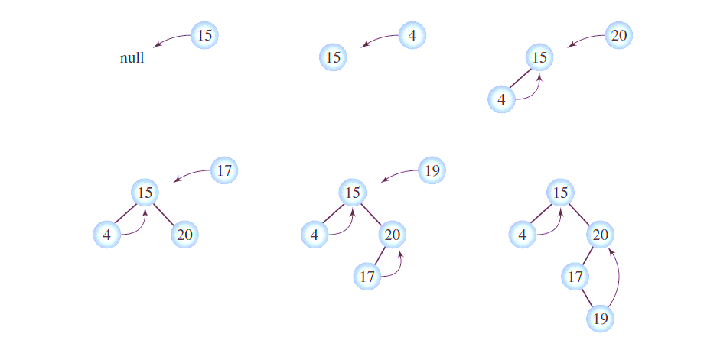
Inserting into a Threaded Binary Tree

Slide 7
Inserting into a Threaded Binary Tree
insert(el)
if root is null // tree is empty;
root becomes a new node with el;
p = root;
while p is not null // find a place for inserting new node;
prev = p;
if el < element in node p
p = p.left;
else if p has no thread
p = p.right;
else break; // do not follow the thread!
if el < element in node prev
new node with el is attached to the left of prev;
new node’s right = prev, hasThread = true;
else if p has a thread
new node’s right = prev.right, hasThread = true;
new node with el is attached to the right of prev;
prev.hasThread = false;
else new node with el is attached to the right of prev;

Slide 8
Deleting a node from BST
How do we delete nodes?
Deleting a leaf is easy:
5
5
3
7
3
7
1
4
6
9
1
6
9

Slide 9
Deleting a node from BST
How do we delete nodes?
Deleting a node with a single child is easy, too:
5
5
3
7
1
7
1
6
9
6
9

Slide 10

Deleting a node from BST
How do we delete nodes?
Deleting a node with two children is less obvious:
3
3
1
8
1
6
10
6
10
5
7
5
7

Slide 11
Delete by merging
Property of BST:
all nodes to the left of n will be < n
all nodes to the right of n will be > n
If we take the largest node on the left, it will be:
> than all other nodes on the left
< than all the right nodes
It will always be the rightmost node of the left branch
3
1
8
6
10
5
7

Slide 12
Delete by merging
Start from the root
Find the node to be deleted
Go left, then find the rightmost node in the left subtree
The right subtree of n becomes the right subtree of the rightmost node
The left child of n takes n’s place
3
3
1
8
1
6
6
10
5
7
5
7
10

Slide 13
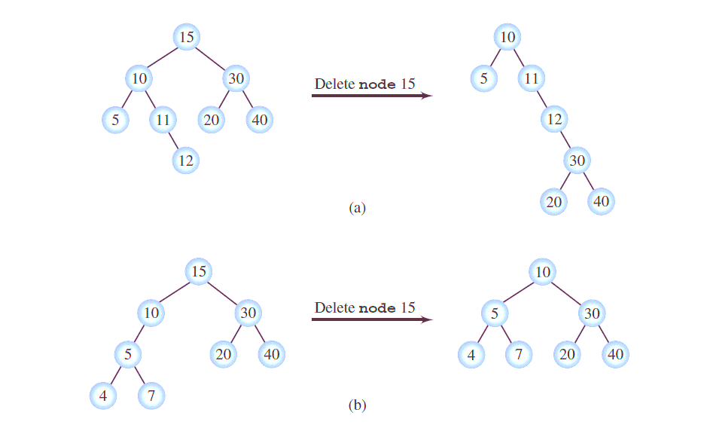
Delete by merging: Tree Height

Slide 14
Delete by Copying
Delete by merging may change the height of the tree and make it inefficient
Is there a better way?
If we take the largest node on the left, it will be:
> than all other nodes on the left
< than all the right nodes
It will always be the rightmost node of the left branch
This node is
> than all nodes in the left branch
< than all the nodes in the right branch
Thus, it is a perfect candidate to replace the deleted node!
Instead of moving around subtrees, we could just take the rightmost node of the left subtree, and replace n with it

Slide 15
Delete by Copying
3
3
1
8
1
7
6
10
6
10
5
7
5
But what if the rightmost node has children?
It’s rightmost, so there is no right child
If there is a left child, it simply becomes the right child of the rightmost node’s parent.

Slide 16
Delete by Copying
20
20
15
20
10
30
10
27
10
27
15
25
35
15
25
35
15
25
35
23
27
27
23
26
27
23
26
26
26
delete 30
delete 20

